Slide 1
Test Plan

Slide 2
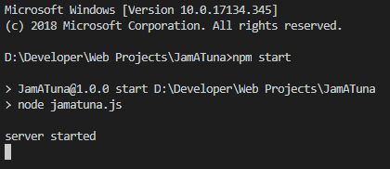
Run Server
Run the following commands in the project directory
npm install
npm start

Slide 3
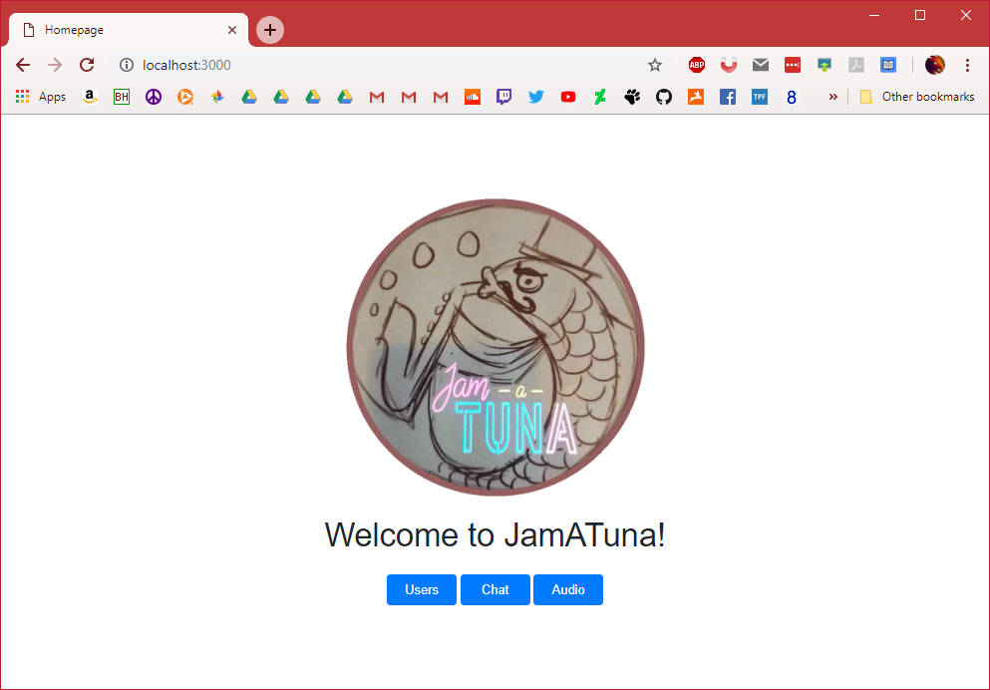
Home Page
Navigate to http://localhost:3000/
Should see Jam-a-Tuna image, text, and buttons
All buttons should work by taking you to a new page
Page should be centered in middle of browser

Slide 4
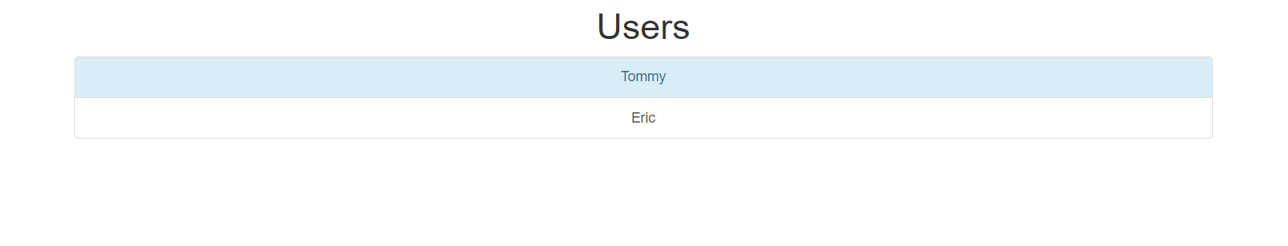
Users Page
Click “Users” button on home page.
Should navigate to http://localhost:3000/html/users.html
Should see list of users
Each user should be clickable
Odd-numbered entries should have a light-blue background.

Slide 5
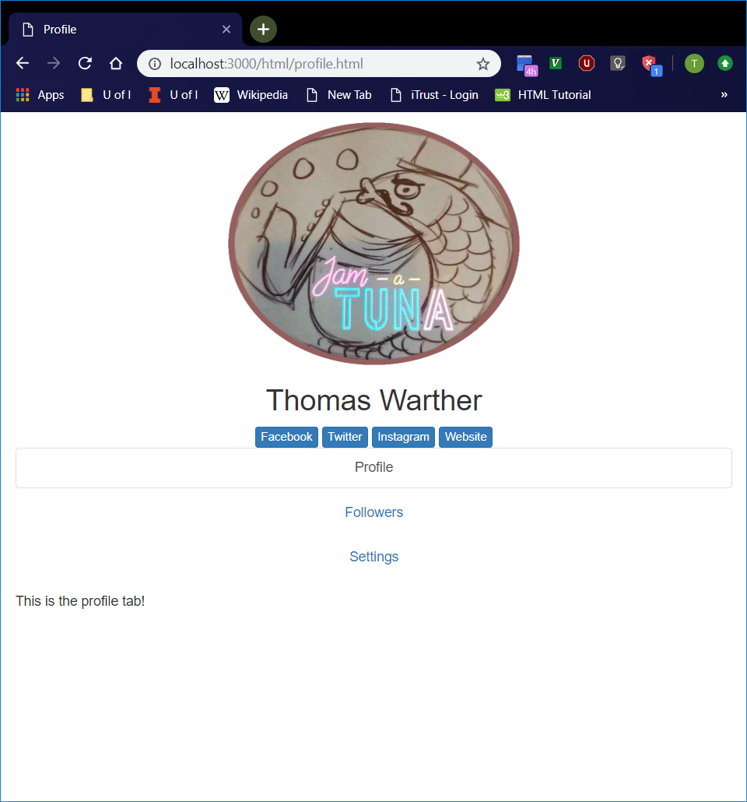
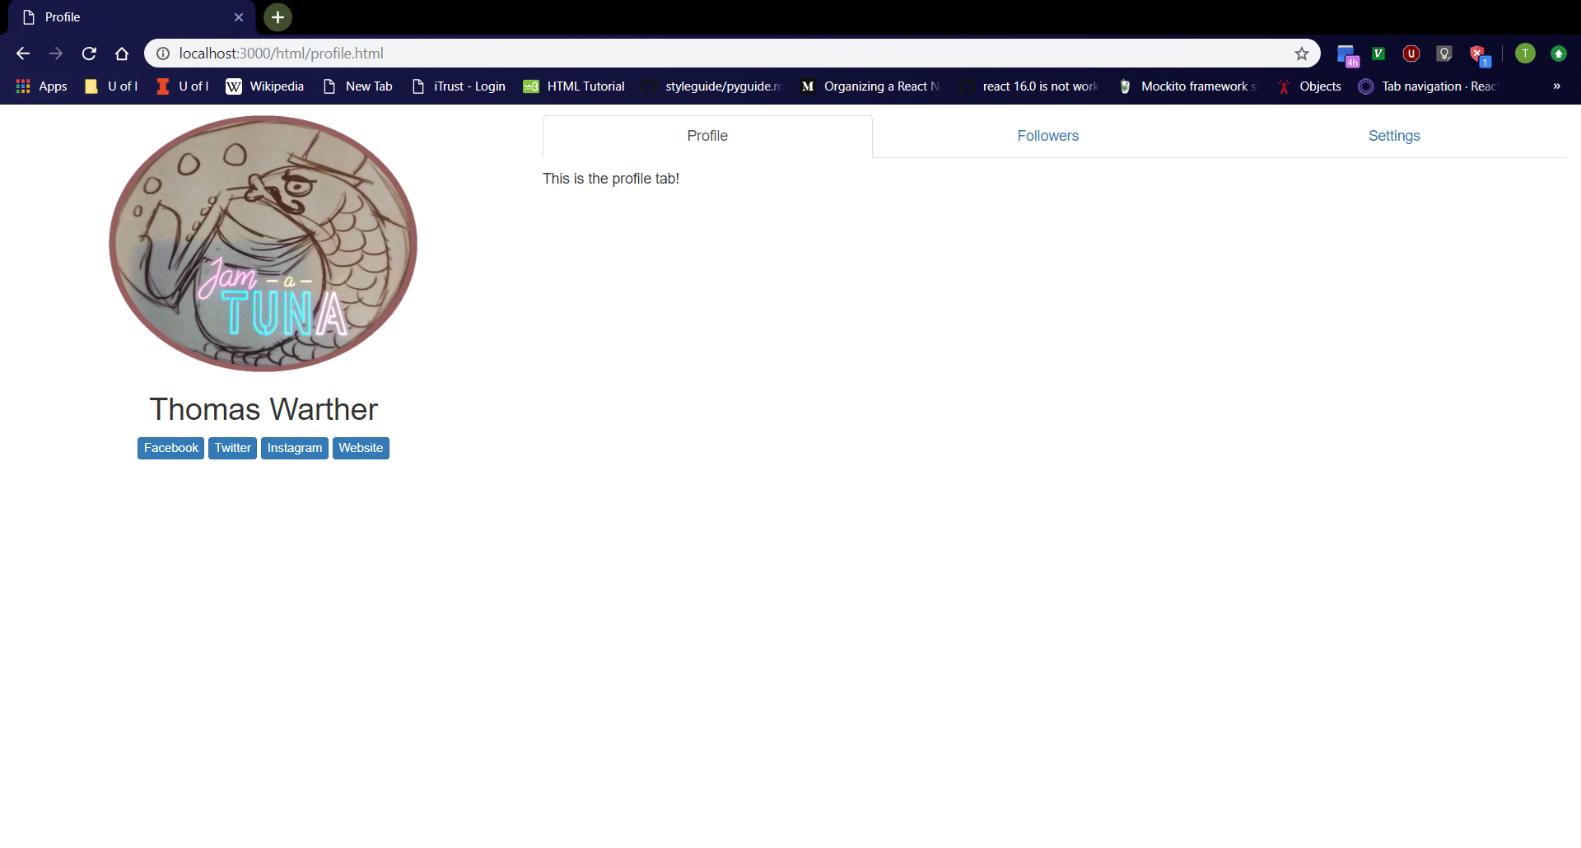
Profile Page
Vertical Window
Click “Tommy” entry on “Users” page.
Should navigate to http://localhost:3000/html/profile.html
Should see profile page with “Profile”, “Followers”, and “Settings” tabs
Tabs should be clickable
Profile page should adjust layout depending on screen orientation.
Full-Sized Window

Slide 6
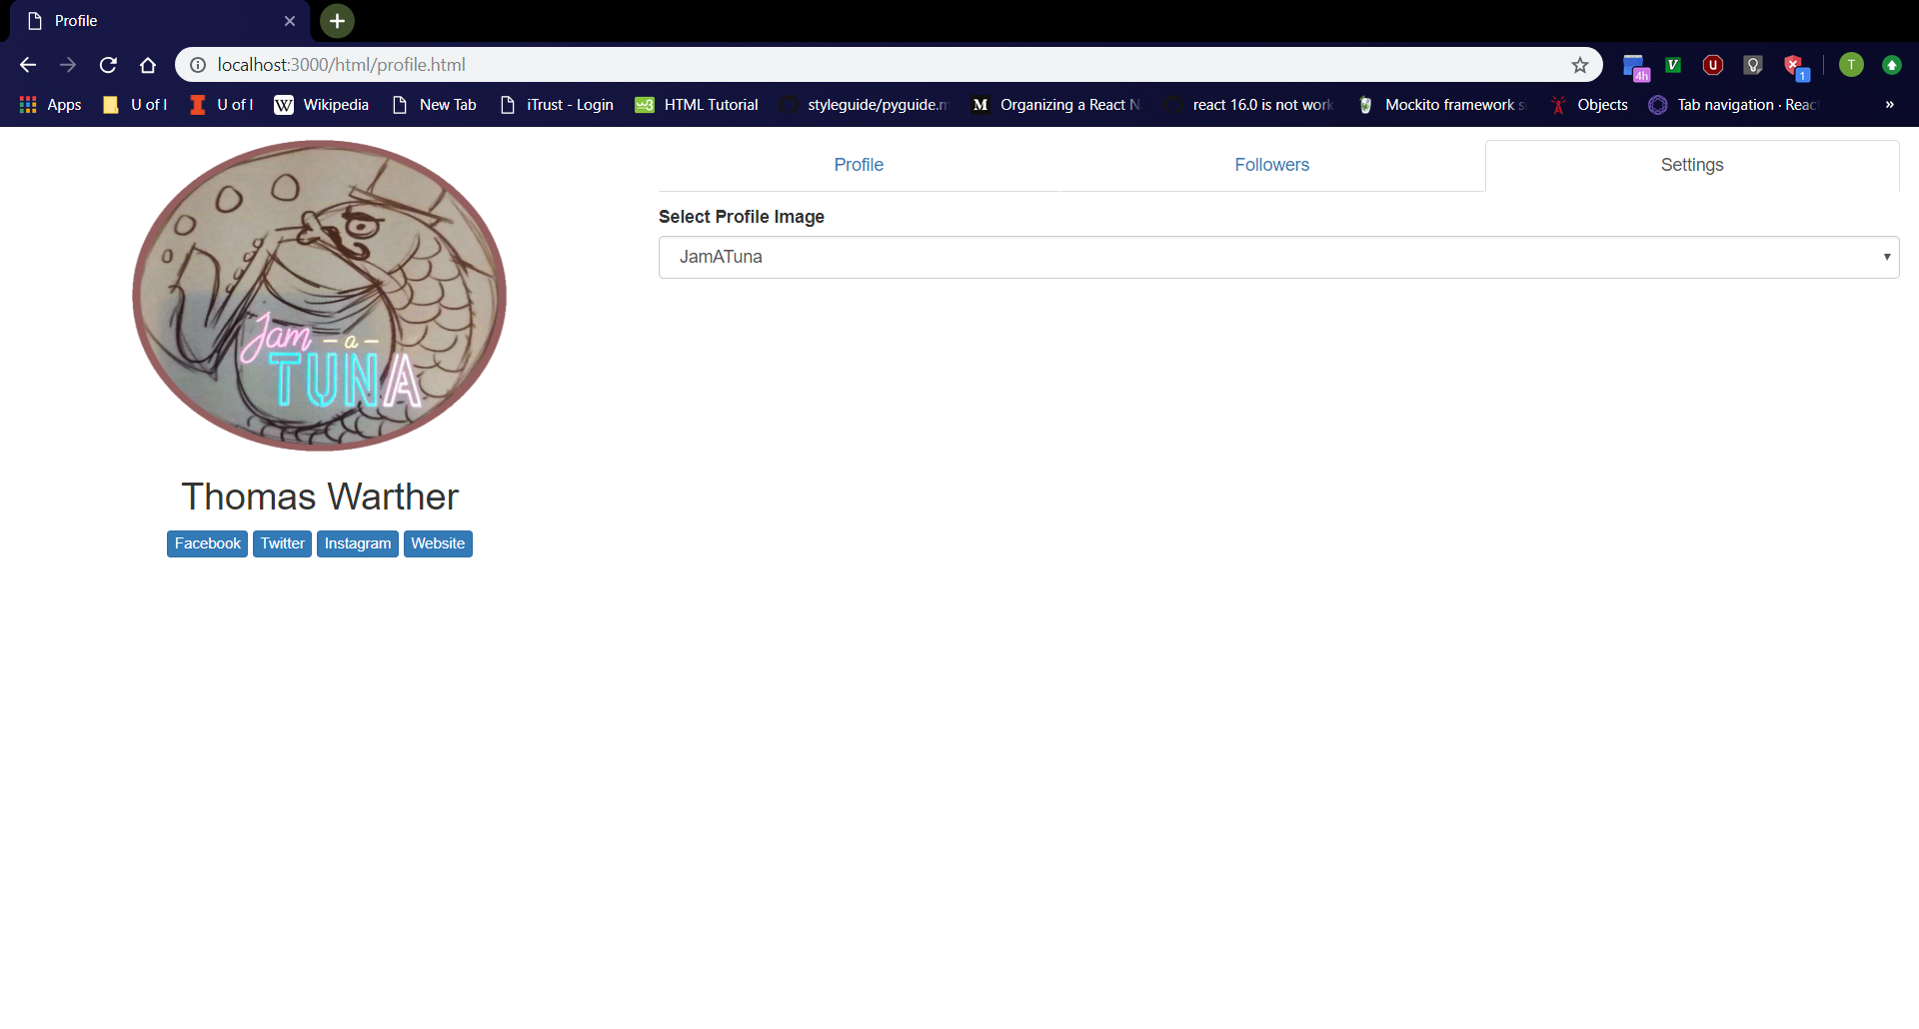
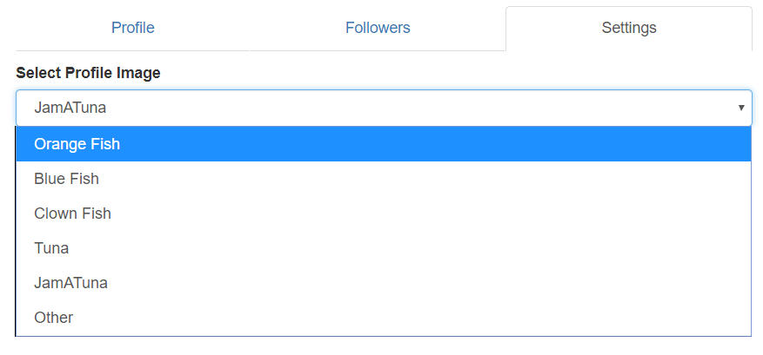
Settings Tab
Settings Tab
Click “Settings” tab on “Profile” page.
Should see dropdown menu with label “Select Profile Image”
Dropdown menu should have “JamATuna” selected by default.
Dropdown menu should have “Orange Fish”, “Blue Fish”, “Clown Fish”, “Tuna”, “JamATuna”, and “Other” options.
Dropdown Menu

Slide 7
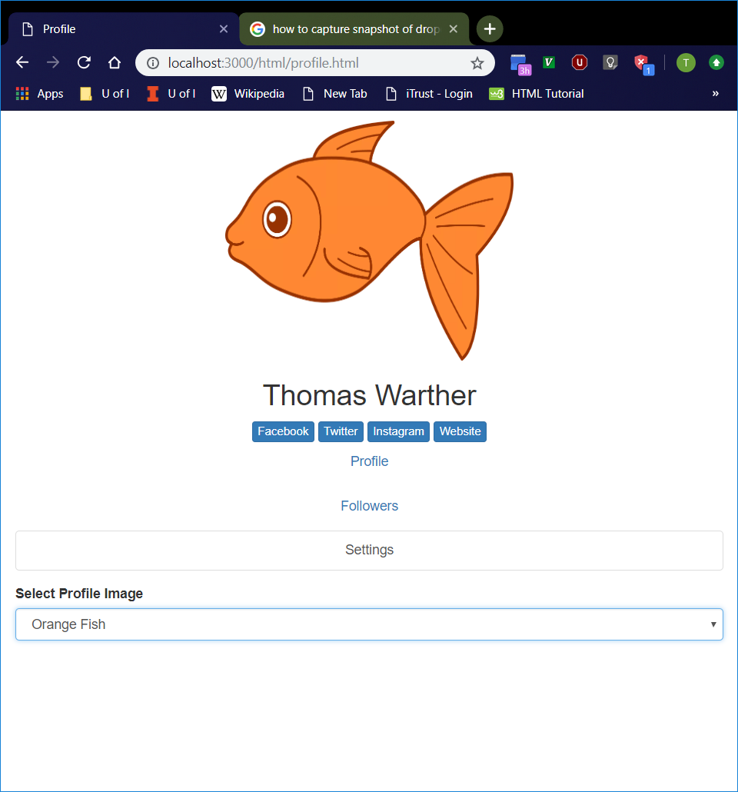
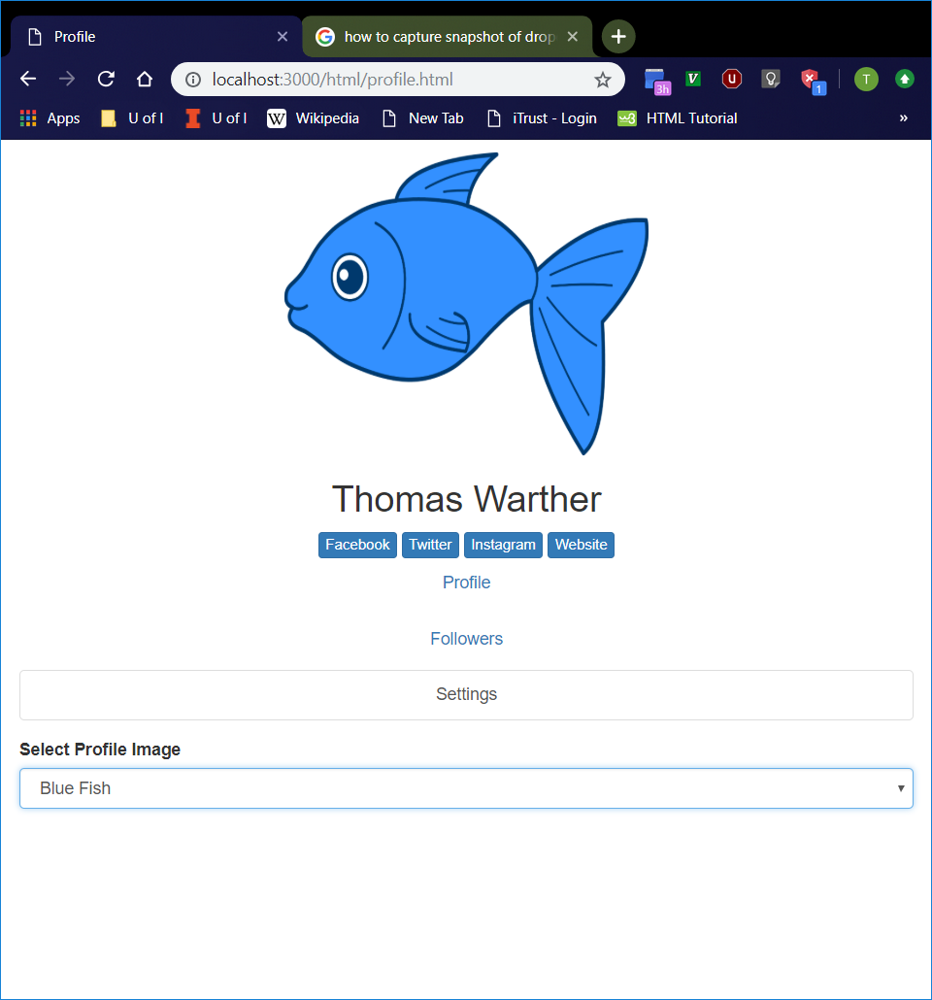
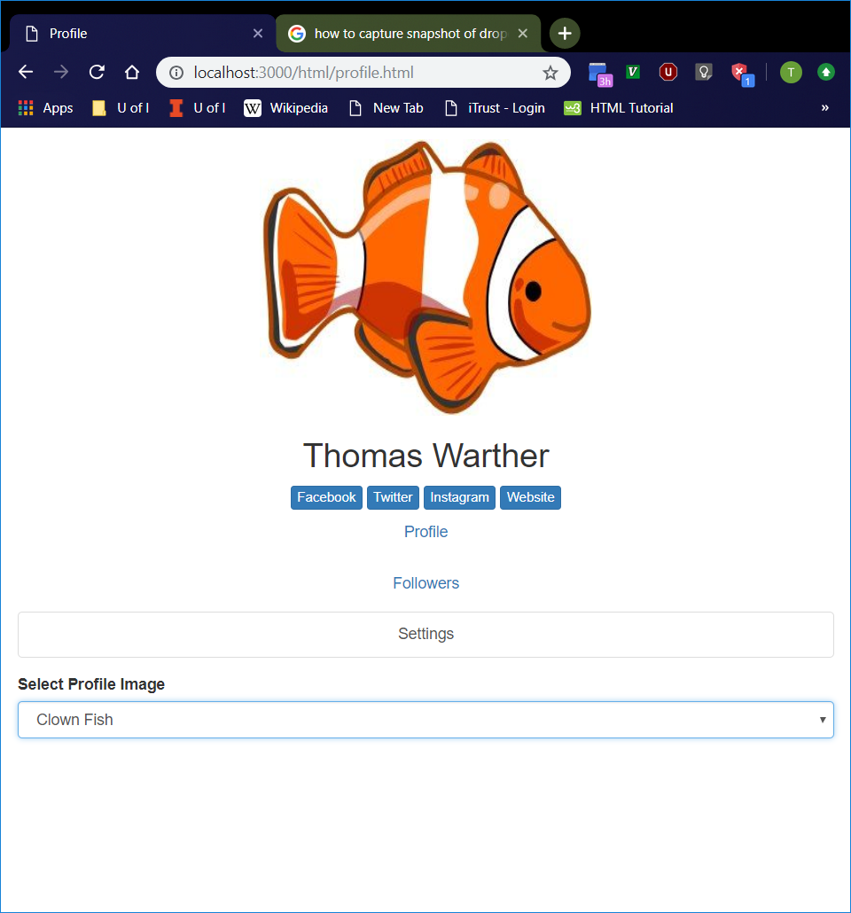
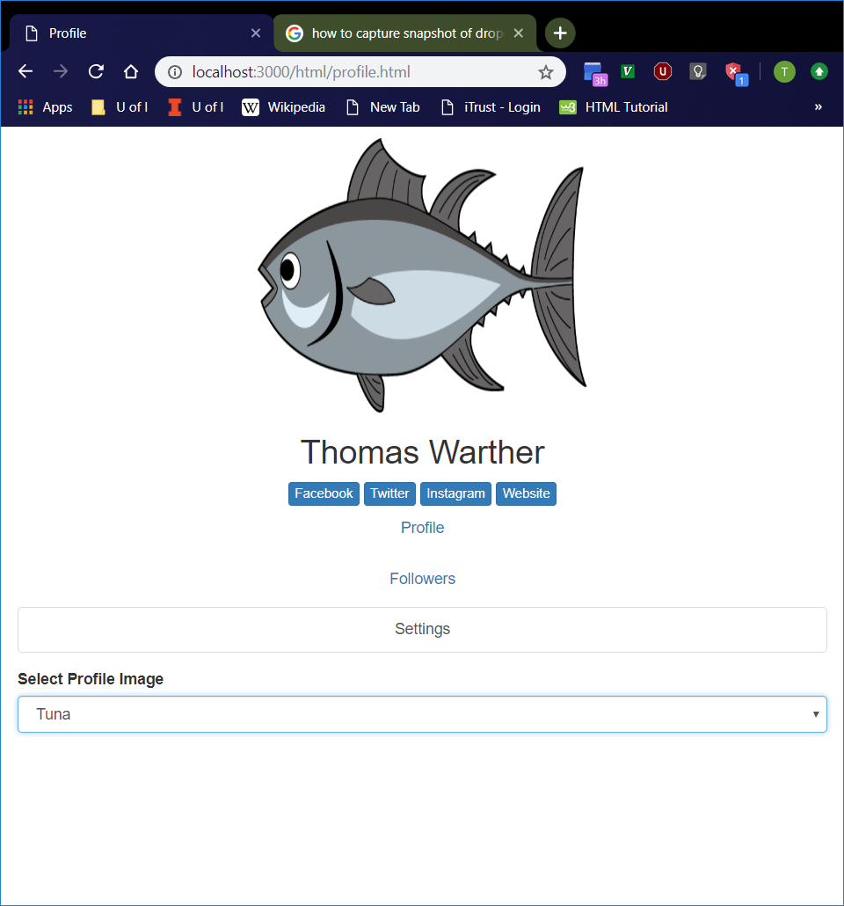
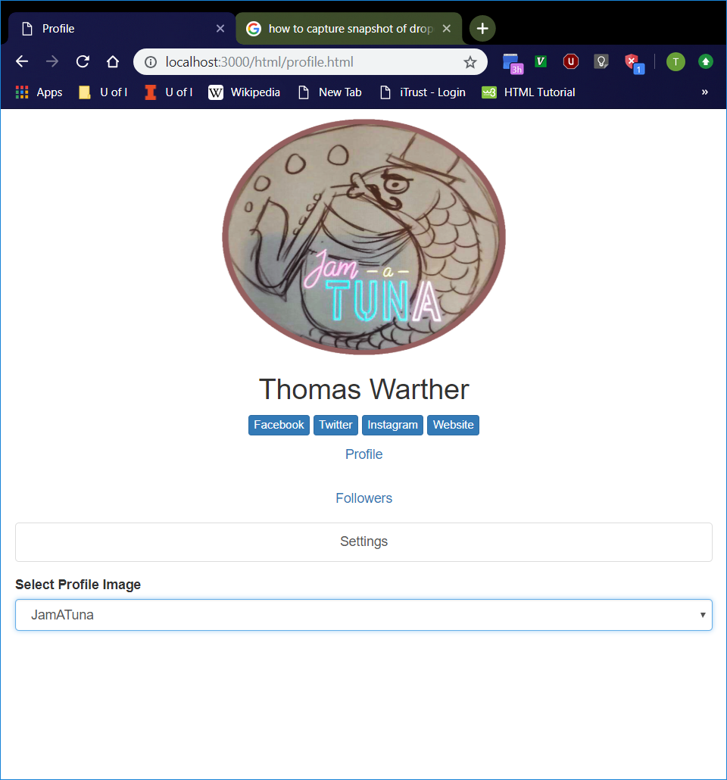
Available Profile Pictures
Select every option in the “Settings” tab dropdown menu, one-by-one except “Other”.
Profile picture should be updated with the appropriate picture.
Orange Fish
Blue Fish
Clown Fish
Tuna
JamATuna

Slide 8
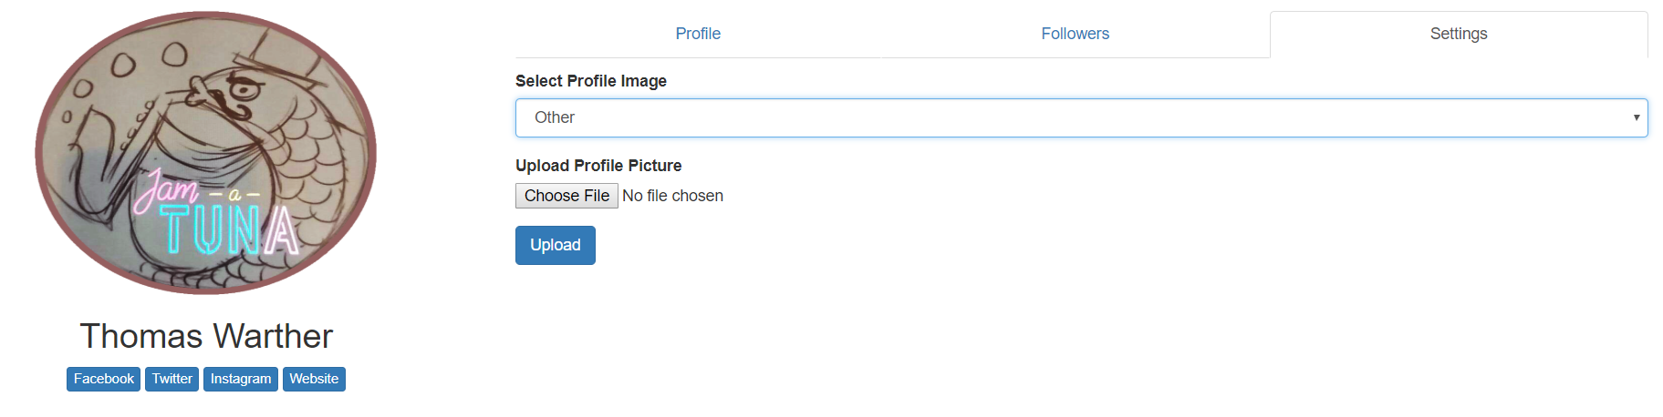
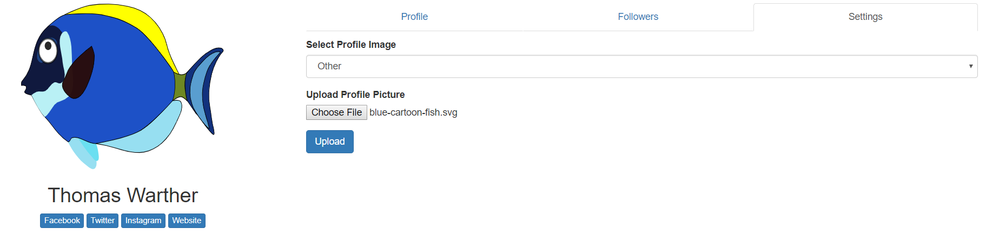
Uploading Profile Pictures
“Upload Profile Picture” Option
Select “Other” from dropdown menu in “Settings tab.
File upload button with “Upload Profile Picture” label and “Upload” button should now appear, and they should disappear after selecting a different option from dropdown menu.
File upload button should bring up File Explorer or similar file upload window
Selecting a file should immediately update the profile picture with the image file.
“Upload” button to be implemented in the future
After Selecting Image File

Slide 9
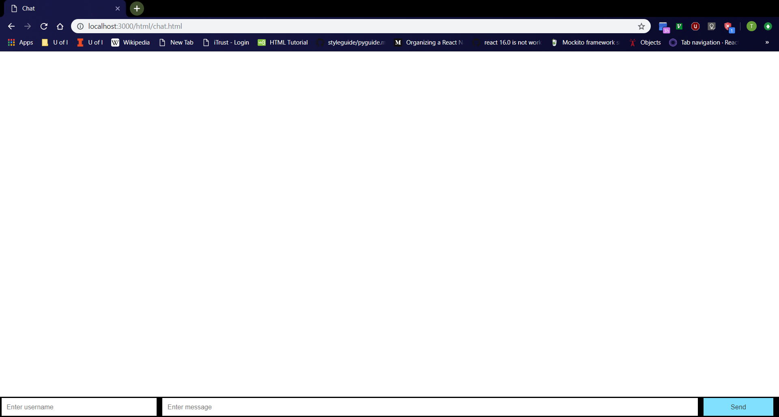
Chat Page
Click “Chat” button on home page.
Should navigate to http://localhost:3000/html/chat.html
From left to right at the bottom of the page, should see username box, message box, then “Send button
Username box should be empty with “Enter username” placeholder.
Message box should be empty with “Enter message” placeholder.

Slide 10
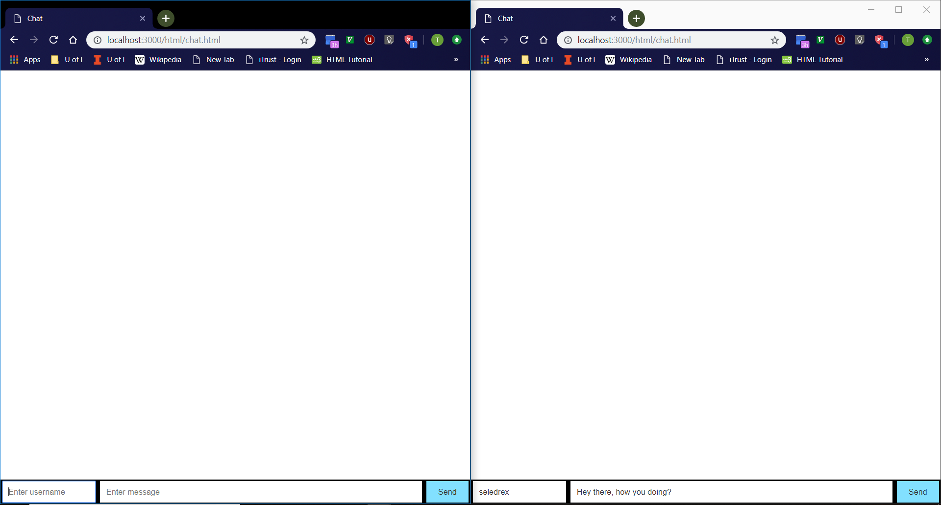
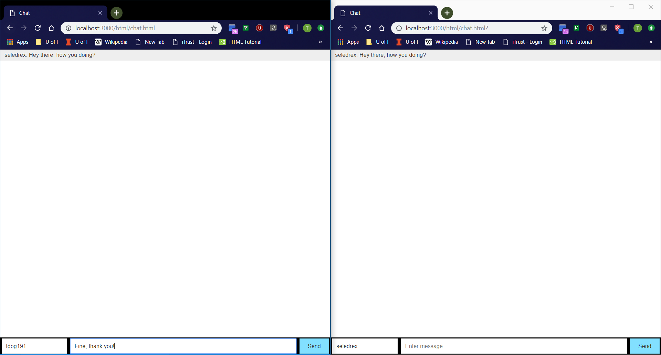

Chat Page Cont.
Open chat page in two browser tabs.
Type username and messages into either tab and hit ‘Enter’.
Messages should show on both tabs.
Every sent message should be of the form “<username>: <message>”.
Every odd-numbered message should have a gray background.
Message box should become empty after a message is sent.

Slide 11
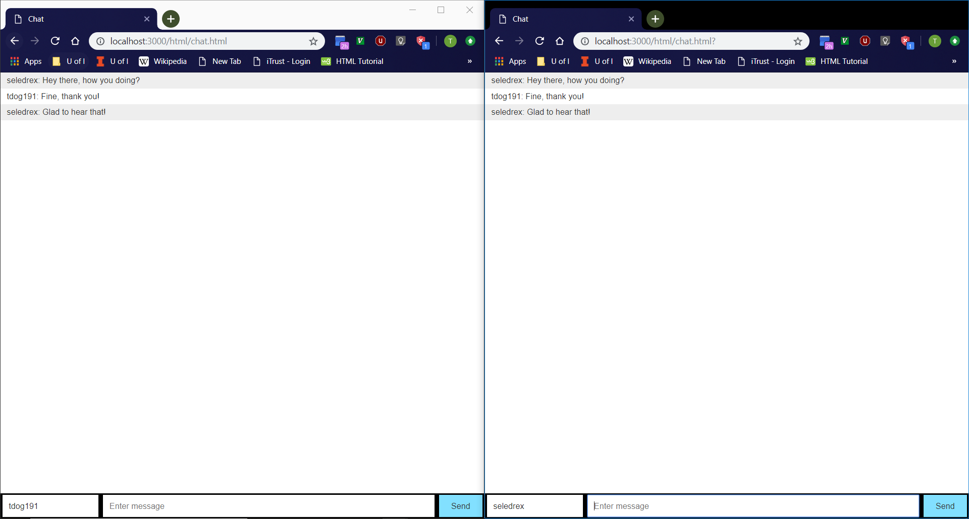
Chat Page Example
Step 1
Step 2
Step 4
Step 3

Slide 12
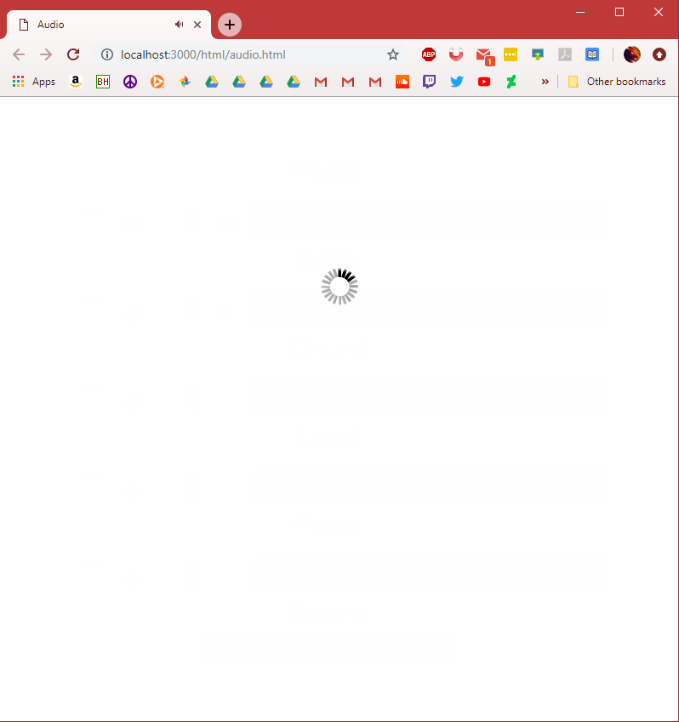
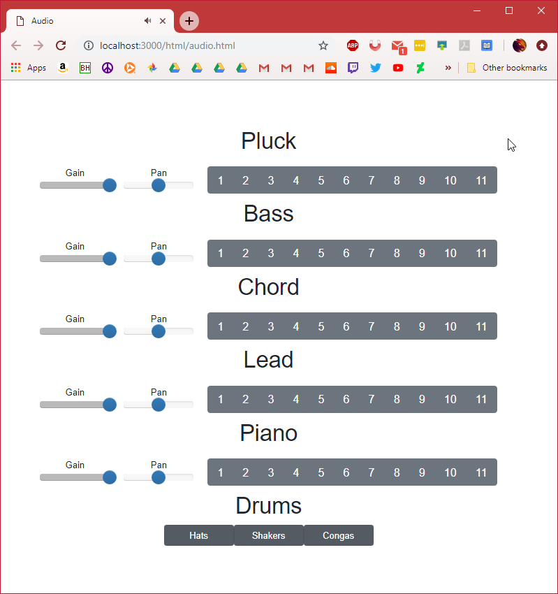
Audio page
Navigate to http://localhost:3000/html/audio.html
Loading screen should appear first
Should see title and buttons centered in screen after
Drum beat should start

Slide 13
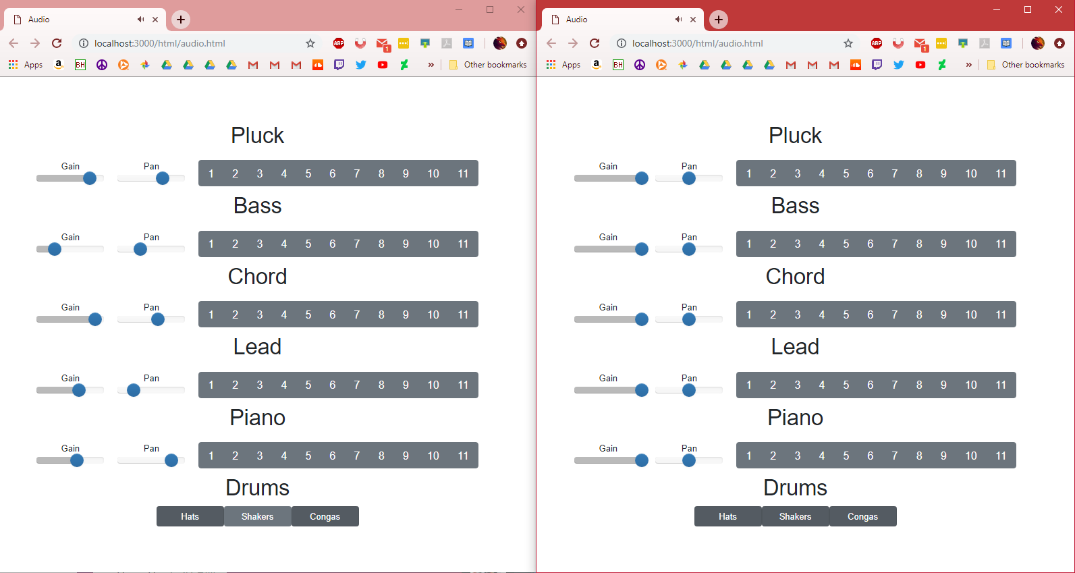
Audio page
Continued
Pressing a button on either tab will play an audio file
Audio files should be played on both tabs
Sound should be in sync no matter how irregular clicks are made
Gain and pan sliders should work

